Slide 1
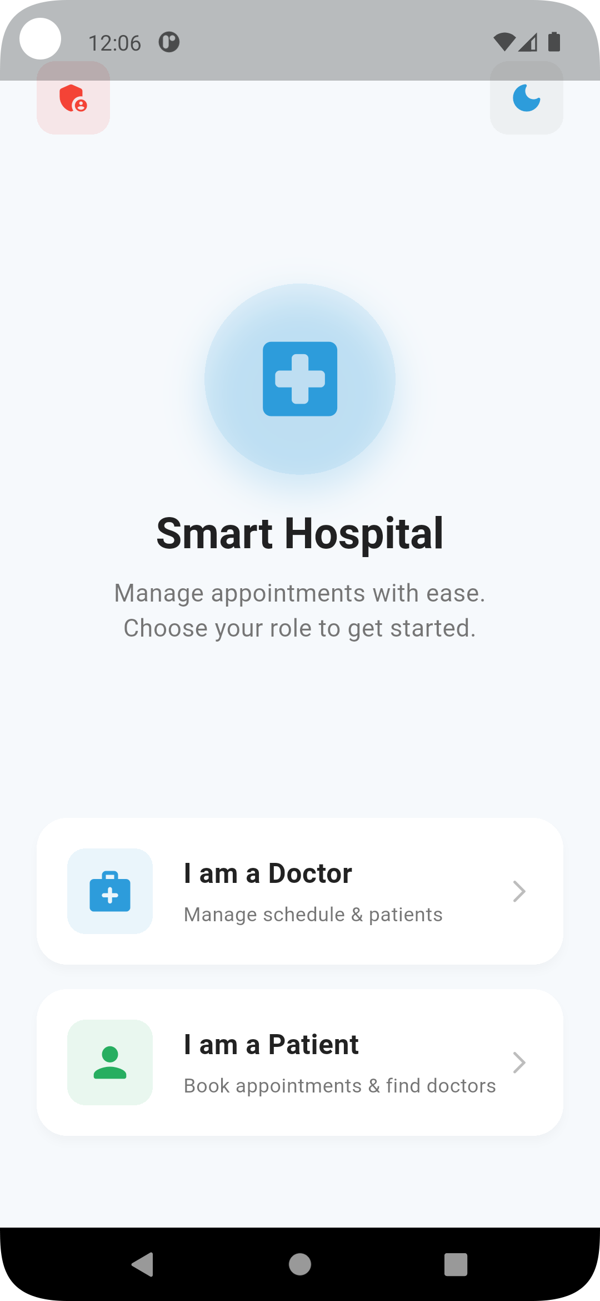
Smart Hospital (Appointment) Management System
Explaining the screen-wise working of a Flutter mobile application.
241911 Syed Shadan Raza
241806 Abdullah Hayat

Slide 2
Introduction
This mobile application is designed to streamline hospital operations and enhance patient care through a user-friendly interface.
The purpose of the app is to provide an efficient and integrated platform for managing various aspects of a hospital, from appointments to staff roles.
It solves the problem of fragmented information, manual processes, and communication gaps often found in traditional hospital management systems.

Slide 3
Objectives
Digital Hospital Management
Role-Based Access
Easy Appointment Handling
To ensure secure and tailored access for different user types.
To create a comprehensive digital platform for all hospital operations.
To simplify the process of scheduling and managing patient appointments.

Slide 4
User Roles
Admin
Doctor
Patient
Manages system settings, user accounts, and overall hospital resources.
Manages patient appointments, medical records, and availability.
Schedules appointments, views medical history, and communicates with doctors.

Slide 5




Overall Application Workflow
App Start
Role Selection
Initiates with a splash screen for branding and loading.
Users choose their role (Admin, Doctor, Patient) to proceed.
Authentication
Role-Based Dashboard
Secure login process to verify user identity.
Displays personalized information and functionalities based on the selected role.

Slide 6

Key Features
1
2
3
Appointment Management
Role-Based Dashboards
Doctor Availability Handling
Customized interfaces for administrators, doctors, and patients.
Seamless scheduling, rescheduling, and cancellation of appointments.
Doctors can update their availability, and patients can view it in real-time.

Slide 7
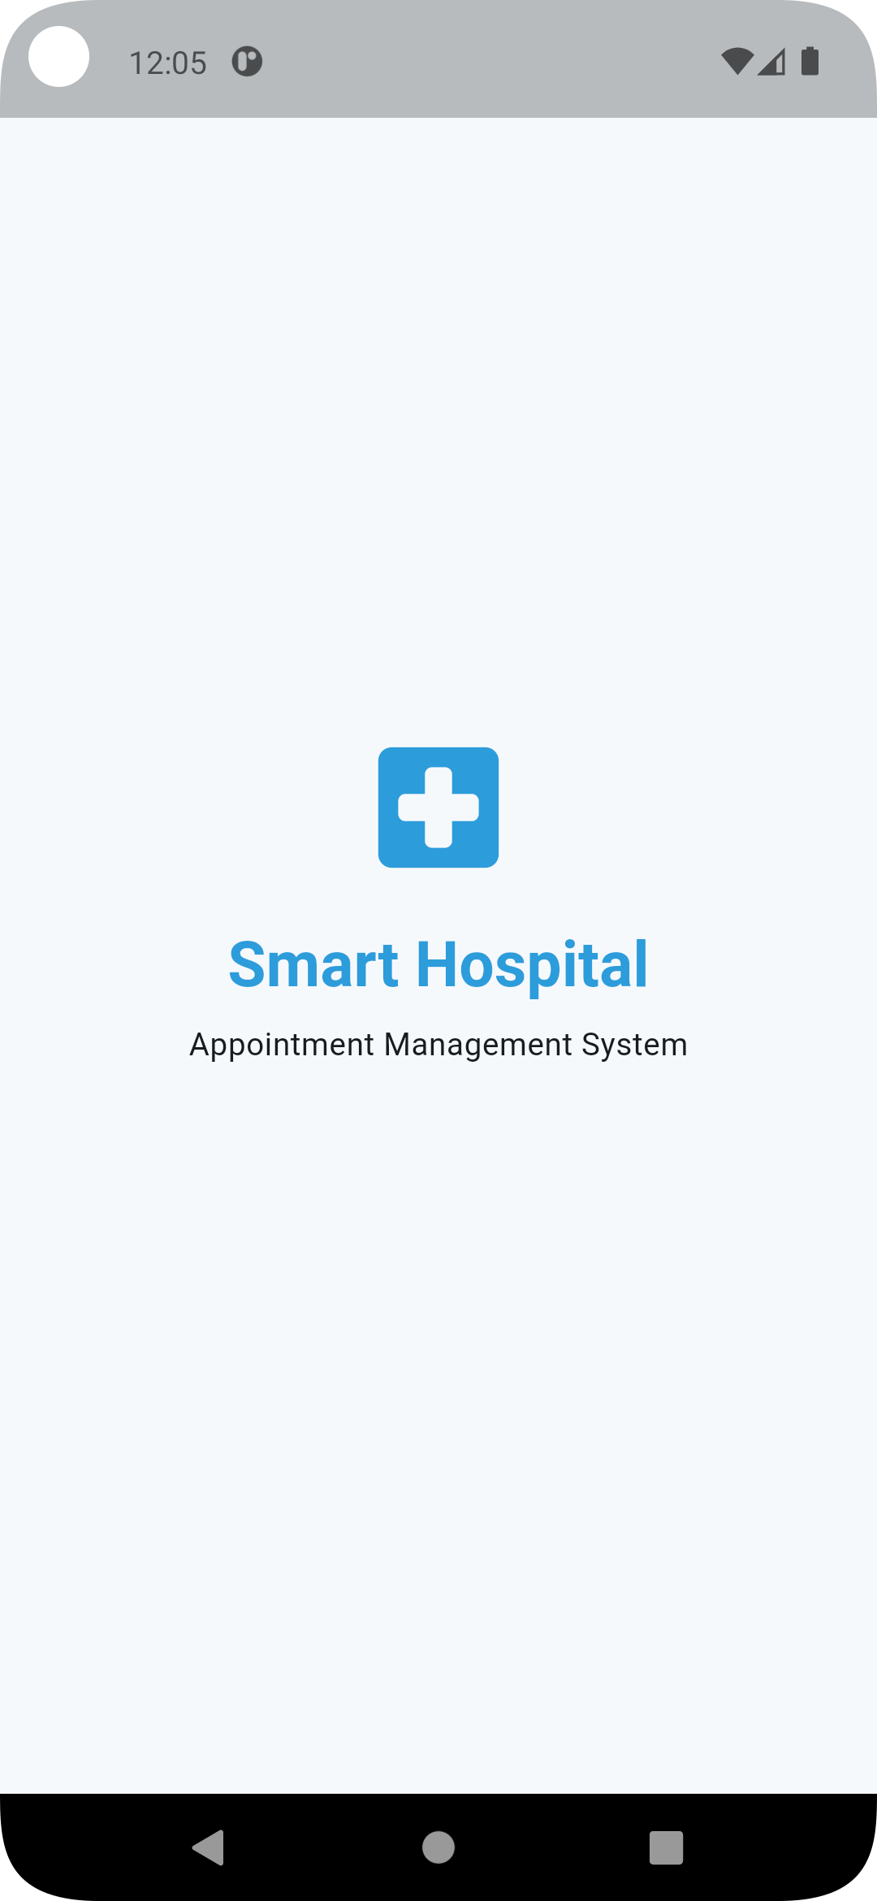
1. Splash Screen
Displays App Logo and Name
Entry Point of Application
The initial screen showcasing the application's branding.
The first interaction point for users upon launching the app.
Navigates Automatically to Role Selection
Seamless transition to the next stage of user interaction.

Slide 8
2. Role Selection Screen
Allows Selection of Admin, Doctor, or Patient
Users choose their role to access specific functionalities.
Determines App Navigation Flow
The selected role dictates the subsequent screens and features available.

Slide 9
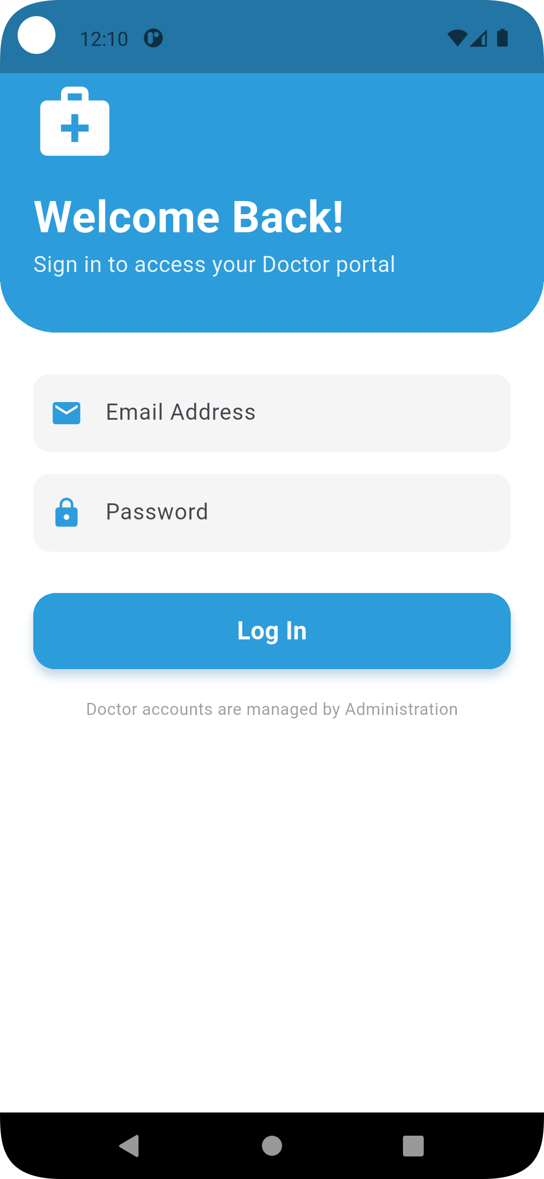
3. Authentication Screen
Login Based on Selected Role
Validates User Credentials
Users provide credentials relevant to their chosen role.
Ensures secure access by verifying user information.
Redirects to Respective Dashboard
Successful authentication leads to the appropriate user interface.

Slide 10
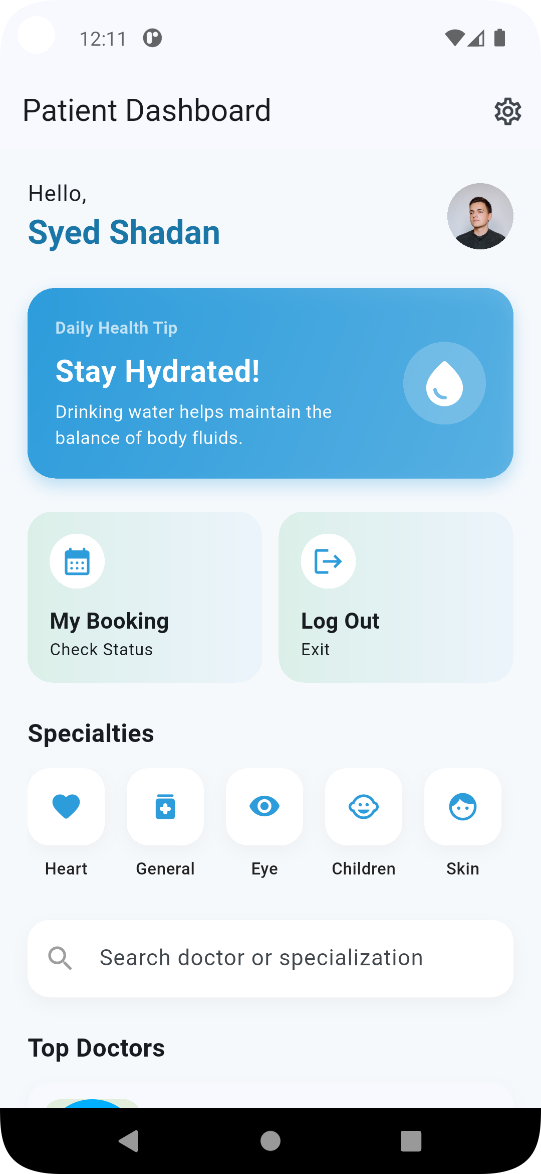
4. Patient Home Screen
Patient Dashboard
Central hub for patient-specific information and actions.
Displays Doctors and Health Tips
Provides relevant information and helpful advice for patients.
Navigation to Appointments
Allows patients to manage and view their scheduled appointments.

Slide 11
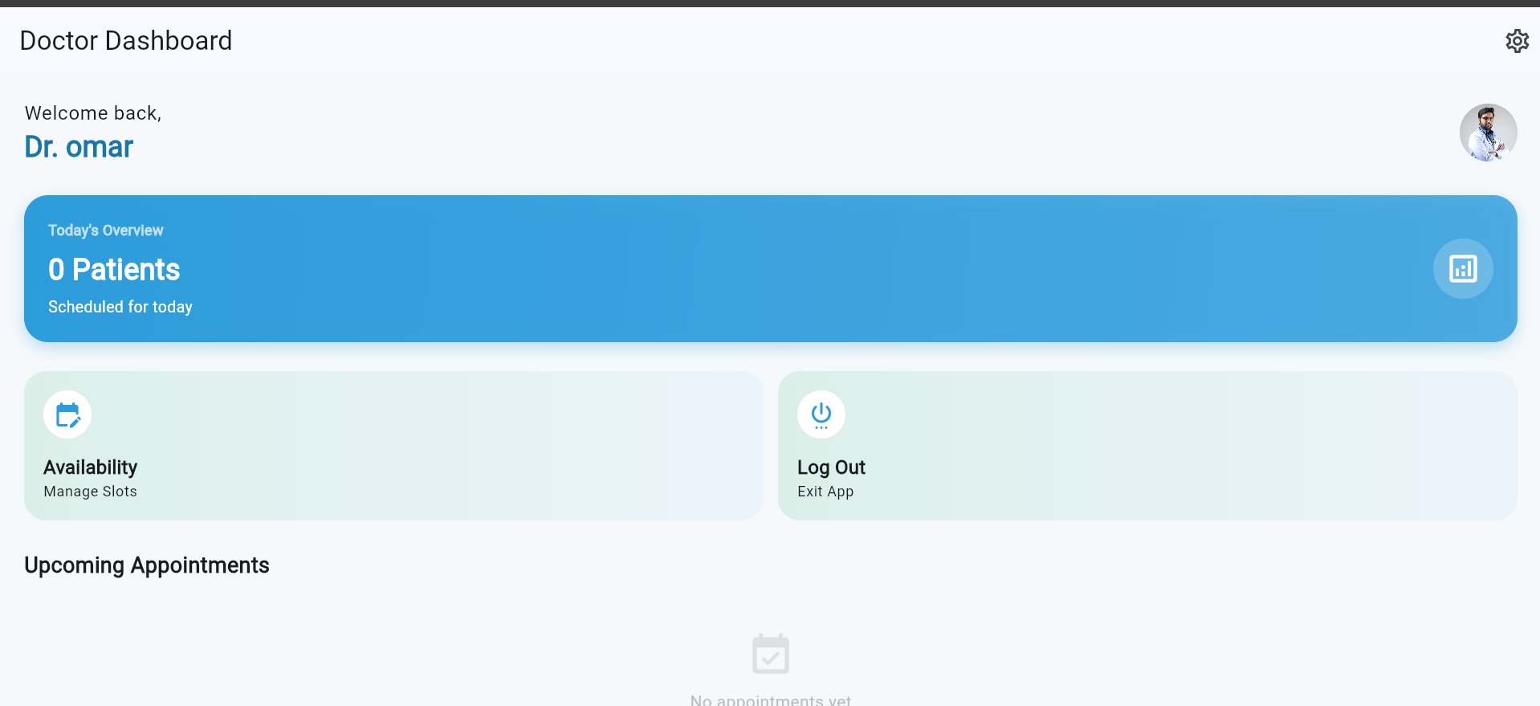
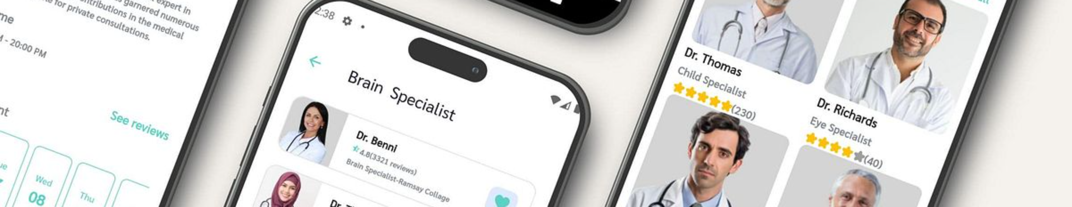
5. Doctor Module Screens
Doctor Dashboard
Availability Management
Appointment Overview
Overview of daily tasks, patient queues, and important notifications.
Doctors can set and update their availability for appointments.
Detailed view of scheduled appointments and patient information.

Slide 12
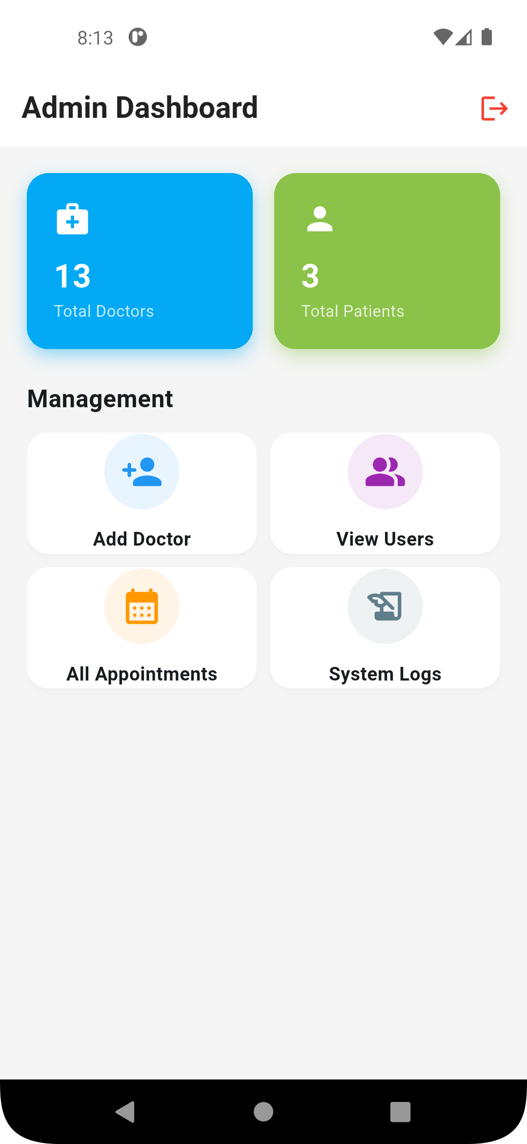
6. Admin Module Screens
Admin Dashboard
Central control panel for managing hospital operations.
System Monitoring
Tools for tracking application performance and user activity.
Hospital Management
Features for managing staff, departments, and resources.

Slide 13






7. Settings Screen
Common for All Users
Preferences
Logout
Accessible by Admin, Doctor, and Patient roles.
Allows users to customize app settings and personal information.
Securely ends the user session.
8. Error Handling & Validation
Input Validation
User-Friendly Error Messages
Ensures data integrity and prevents incorrect entries.
Provides clear and helpful feedback to users when errors occur.

Slide 14
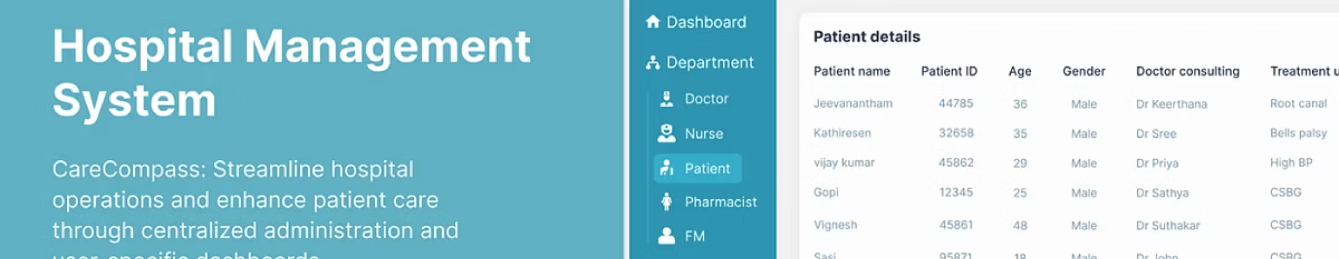
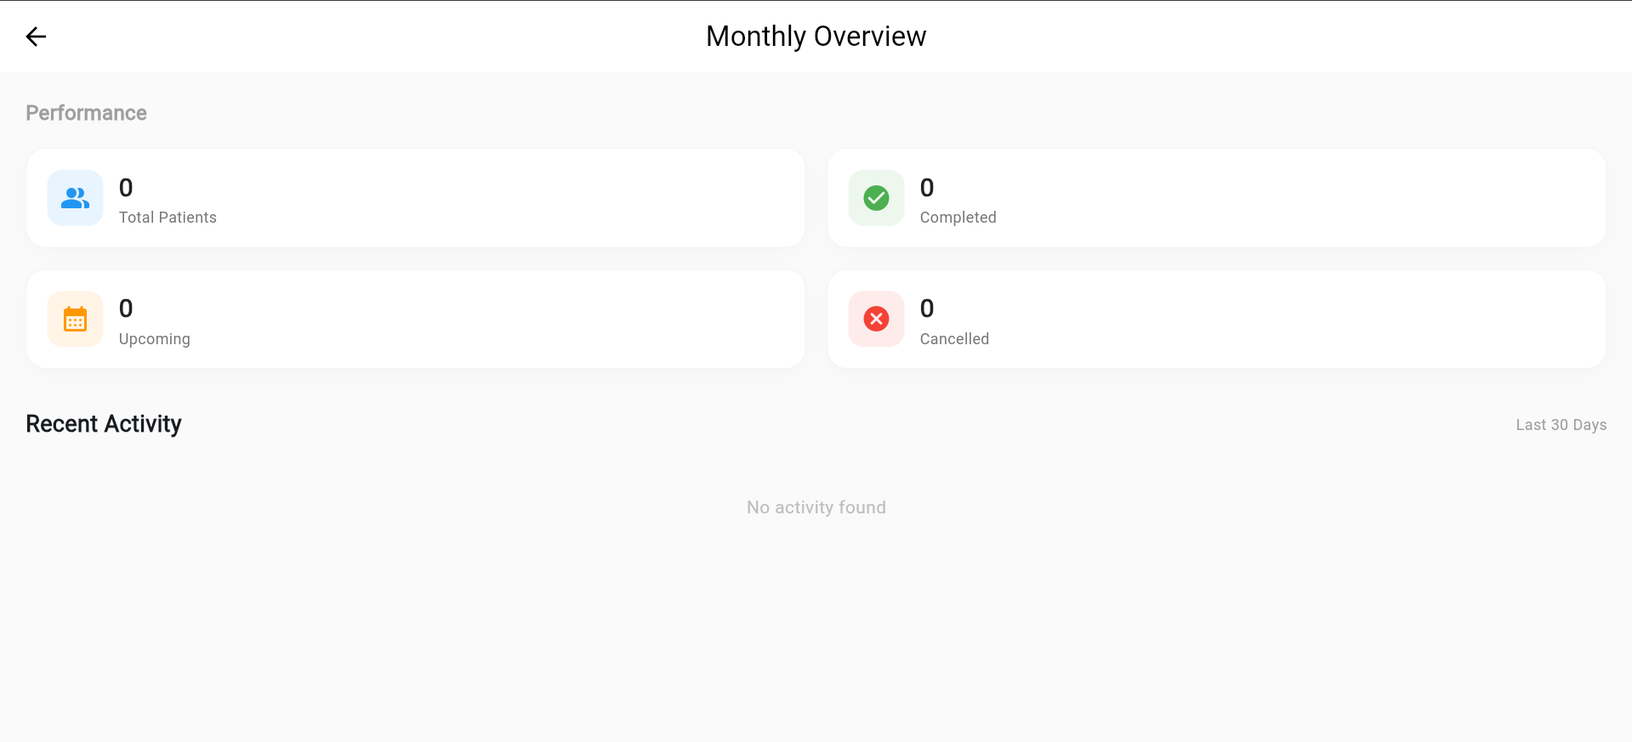
9. Conclusion
Summary of Screen-Wise Working
Role-Based Functionality
A concise overview of the application's flow and functionality.
Highlighting the distinct features available to each user role.

Slide 15

Thank You
For your attention and consideration of our project.

